Slide 1
Data Warehousing and Data Mining
BScCSIT 8th Semester
Lecturer : Bijay Mishra

Slide 2
Course Overview
Course Title: Data Warehousing and Data Mining
Course no: CSC-459
Credit hours: 3
Nature of course: Theory (3 Hrs.) + Lab (3 Hrs.)
Full Marks: 60+20+20
Pass Marks: 24+8+8
Prerequisite: C, Data Structure, Database

Slide 3

Text Books

Slide 4
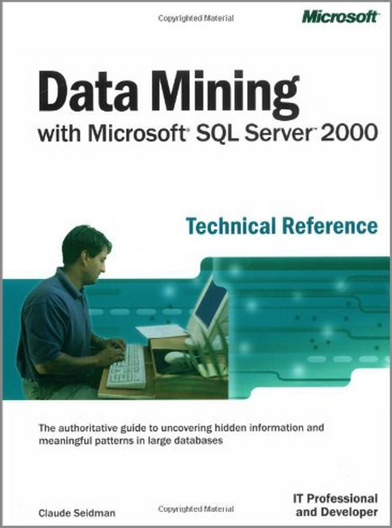

Slide 5
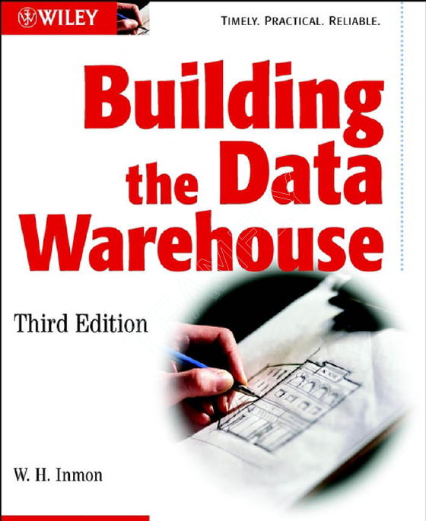
Reference Books

Slide 6
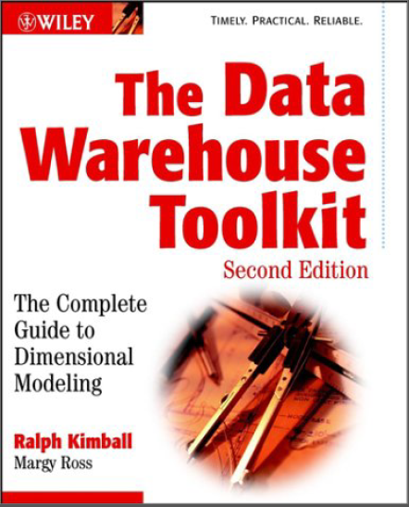

Slide 7
Unit 1 : Introduction to Data Mining and Data Warehousing

Slide 9
What is Data?
A representation of facts, concepts, or instructions in a formal manner suitable for communication, interpretation, or processing by human beings or by computers.
??
Wisdom
Knowledge
Information
Data

Slide 10
Review of basic concepts of data warehousing and data mining
The Explosive Growth of Data: from terabytes to petabytes
Data accumulate and double every 9 months
High-dimensionality of data
High complexity of data
New and sophisticated applications
There is a big gap from stored data to knowledge; and the transition won’t occur automatically.
Manual data analysis is not new but a bottleneck
Fast developing Computer Science and Engineering generates new demands

Slide 11
Evolution of Database Technology
1960s:
Data collection, database creation, IMS and network DBMS
1970s:
Relational data model, relational DBMS implementation
1980s:
RDBMS, advanced data models (extended-relational, OO, deductive, etc.) and application-oriented DBMS (spatial, scientific, engineering, etc.)
1990s—2000s:
Data mining and data warehousing, multimedia databases, and Web databases

Slide 12
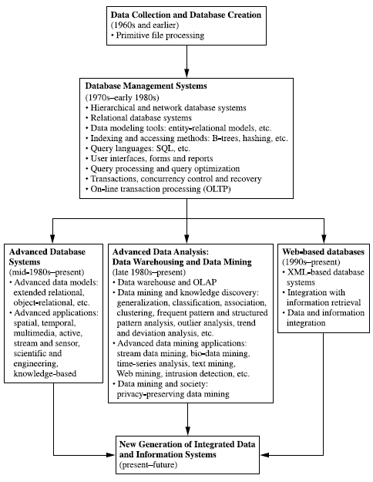
Figure: The evolution of database system technology

Slide 13
Very Large Databases
Terabytes -- 10^12 bytes:
Petabytes -- 10^15 bytes:
Exabytes -- 10^18 bytes:
Zettabytes -- 10^21 bytes:
Zottabytes -- 10^24 bytes:
Walmart -- 24 Terabytes
Geographic Information Systems
National Medical Records
Weather images
Intelligence Agency Videos

Slide 14
Data explosion problem
Automated data collection tools and mature database technology lead to tremendous amounts of data accumulated and/or to be analyzed in databases, data warehouses, and other information repositories
We are drowning in data, but starving for knowledge!
Solution:
“Necessity is the mother of invention”—Data Warehousing and Data Mining

Slide 15
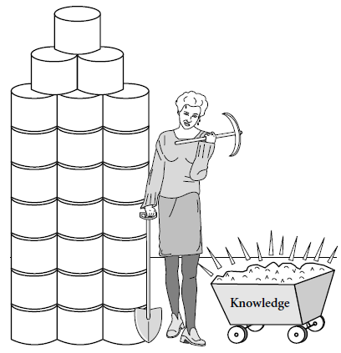
What is Data Mining?
Art/Science of extracting non-trivial, implicit,
previously unknown, valuable, and potentially
Useful information from a large database

Slide 16
Data mining is
A hot buzzword for a class of techniques that find patterns in data
A user-centric, interactive process which leverages analysis technologies and computing power
A group of techniques that find relationships that have not previously been discovered
Not reliant on an existing database
A relatively easy task that requires knowledge of the business problem/subject matter expertise

Slide 17
Data mining is not
Brute-force crunching of bulk data
“Blind” application of algorithms
Going to find relationships where none exist
Presenting data in different ways
A difficult to understand technology requiring an advanced degree in computer science

Slide 18
Data mining is not
A cybernetic magic that will turn your data into gold. It’s the process and result of knowledge production, knowledge discovery and knowledge management.
Once the patterns are found Data Mining process is finished.
Queries to the database are not DM.

Slide 19
Data Warehouse

Slide 20
What is Data Warehouse?
According to W. H. Inmon, a data warehouse is a subject-oriented, integrated, time-variant, nonvolatile collection of data in support of management decisions.
“A data warehouse is a copy of transaction data specifically structured for querying and reporting” – Ralph Kimball
Data Warehousing is the process of building a data warehouse for an organization.
Data Warehousing is a process of transforming data into information and making it available to users in a timely enough manner to make a difference

Slide 21
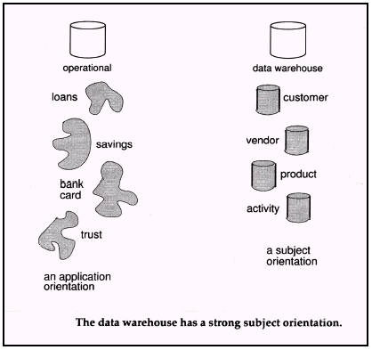
Subject Oriented
Focus is on Subject Areas rather than Applications
Organized around major subjects, such as customer, product, sales.
Provide a simple and concise view around particular subject issues by excluding data that are not useful in the decision support process.

Slide 22
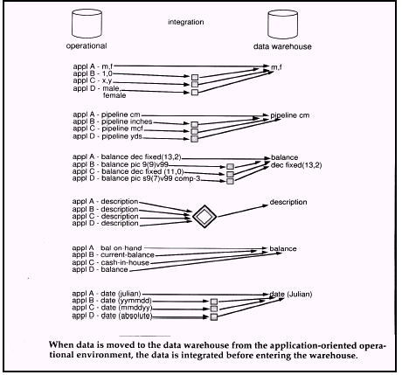
Integrated
Constructed by integrating multiple, heterogeneous data sources
Integration tasks handles naming conventions, physical attributes of data
Must be made consistent.

Slide 23
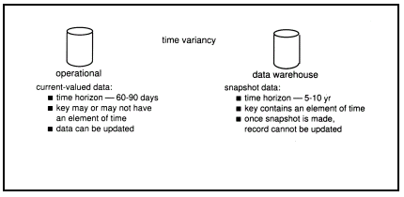
Time Variant
Only accurate and valid at some point in time or over some time interval.
The time horizon for the data warehouse is significantly longer than that of operational systems.
Operational database provides current value data.
Data warehouse data provide information from a historical perspective (e.g., past 5-10 years)

Slide 24
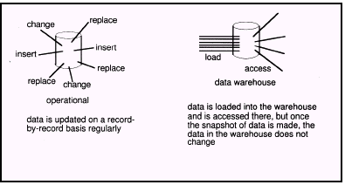
Non Volatile
Data Warehouse is relatively Static in nature.
Not updated in real-time but data in the data warehouse is loaded and refreshed from operational systems, it is not updated by end users.

Slide 25
Data warehousing helps business managers to :
Extract data from various source systems on different platforms
Transform huge data volumes into meaningful information
Analyze integrated data across multiple business dimensions
Provide access of the analyzed information to the business users anytime anywhere

Slide 26
OLTP vs. Data Warehouse
Online Transaction Processing (OLTP) systems are tuned for known transactions and workloads while workload is not known a priori in a data warehouse
OLTP applications normally automate clerical data processing tasks of an organization, like data entry and enquiry, transaction handling, etc. (access, read, update)
Special data organization, access methods and implementation methods are needed to support data warehouse queries (typically multidimensional queries)
e.g., average amount spent on phone calls between 9AM-5PM in Kathmandu during the month of March, 2012

Slide 27
OLTP
Application Oriented
Used to run business
Detailed data
Current up to date
Isolated Data
Repetitive access
Clerical User
Data Warehouse
Subject Oriented
Used to analyze business
Summarized and refined
Snapshot data
Integrated Data
Ad-hoc access
Knowledge User (Manager)

Slide 28
OLTP
Performance Sensitive
Few Records accessed at a time (tens)
Read/Update Access
No data redundancy
Database Size 100MB -100 GB
Data Warehouse
Performance relaxed
Large volumes accessed at a time(millions)
Mostly Read (Batch Update)
Redundancy present
Database Size 100 GB - few terabytes

Slide 29
OLTP
Transaction throughput is the performance metric
Thousands of users
Managed in entirety
Data Warehouse
Query throughput is the performance metric
Hundreds of users
Managed by subsets

Slide 30
Why Data Mining?
Because it can improve customer service, better target marketing campaigns, identify high-risk clients, and improve production processes. In short, because it can help you or your company make or save money.
Data mining has been used to:
Identify unexpected shopping patterns in supermarkets.
Optimize website profitability by making appropriate offers to each visitor.
Predict customer response rates in marketing campaigns.
Defining new customer groups for marketing purposes.
Predict customer defections: which customers are likely to switch to an alternative supplier in the near future.
Distinguish between profitable and unprofitable customers.
Identify suspicious (unusual) behavior, as part of a fraud detection process.

Slide 31
Data analysis and decision support
Market analysis and management
Target marketing, customer relationship management (CRM), market basket analysis, cross selling, market segmentation
Risk analysis and management
Forecasting, customer retention, improved underwriting, quality control, competitive analysis
Fraud detection and detection of unusual patterns (outliers)
Other Applications
Text mining (news group, email, documents) and Web mining
Stream data mining
Bioinformatics and bio-data analysis

Slide 32
Market Analysis and Management
Where does the data come from?—Credit card transactions, loyalty cards, discount coupons, customer complaint calls, plus (public) lifestyle studies
Target marketing
Find clusters of “model” customers who share the same characteristics: interest, income level, spending habits, etc.
Determine customer purchasing patterns over time
Cross-market analysis—Find associations/co-relations between product sales, & predict based on such association
Customer profiling—What types of customers buy what products (clustering or classification)
Customer requirement analysis
Identify the best products for different groups of customers
Predict what factors will attract new customers
Provision of summary information
Multidimensional summary reports
Statistical summary information (data central tendency and variation)

Slide 33
Corporate Analysis & Risk Management
Finance planning and asset evaluation
cash flow analysis and prediction
contingent claim analysis to evaluate assets
cross-sectional and time series analysis (financial-ratio, trend analysis, etc.)
Resource planning
summarize and compare the resources and spending
Competition
monitor competitors and market directions
group customers into classes and a class-based pricing procedure
set pricing strategy in a highly competitive market

Slide 34
Fraud Detection & Mining Unusual Patterns
Approaches: Clustering & model construction for frauds, outlier analysis
Applications: Health care, retail, credit card service, telecomm.
Auto insurance: ring of collisions
Money laundering: suspicious monetary transactions
Medical insurance
Professional patients, ring of doctors, and ring of references
Unnecessary or correlated screening tests
Telecommunications: phone-call fraud
Phone call model: destination of the call, duration, time of day or week. Analyze patterns that deviate from an expected norm
Retail industry
Analysts estimate that 38% of retail shrink is due to dishonest employees
Anti-terrorism

Slide 35
Knowledge Discovery in Databases Process
Data selection
Cleaning
Enrichment
Coding
Data Mining
Reporting

Slide 36
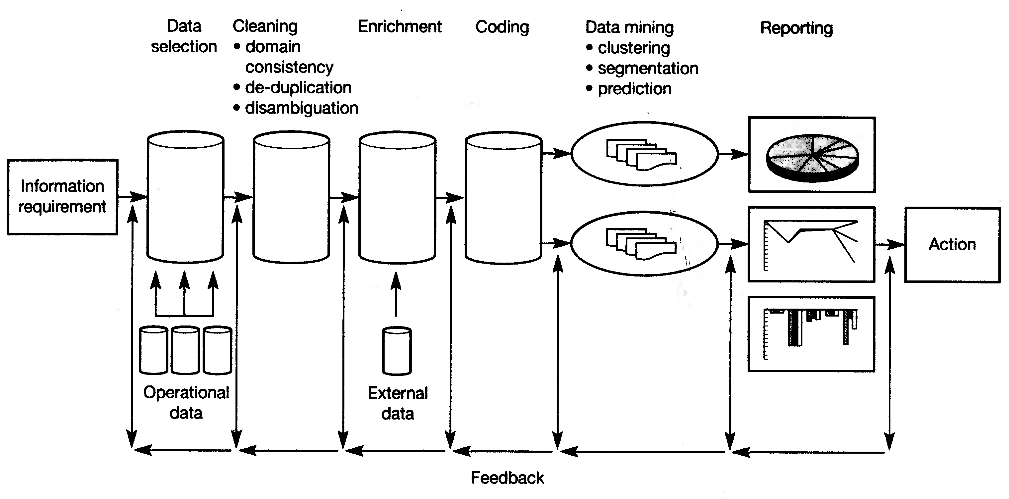
Figure: Knowledge Discovery in Databases (KDD) Process

Slide 37
Data Selection
Once you have formulated your informational requirements, the nest logical step is to collect and select the data you need. Setting up a KDD activity is also a long term investment. A data environment will need to download from operational data on a regular basis, therefore investing in a data warehouse is an important aspect of the whole process.

Slide 38
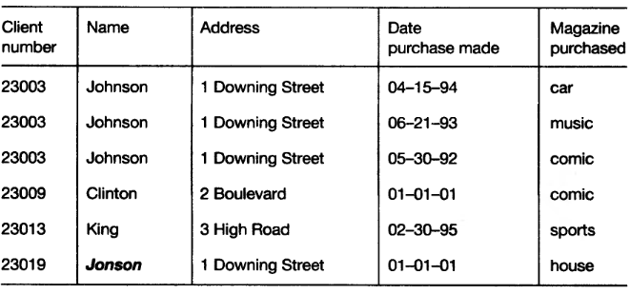
Figure: Original Data

Slide 39
Cleaning
Almost all databases in large organizations are polluted and when we start to look at the data from a data mining perspective, ideas concerning consistency of data change. Therefore, before we start the data mining process, we have to clean up the data as much as possible, and this can be done automatically in many cases.

Slide 40
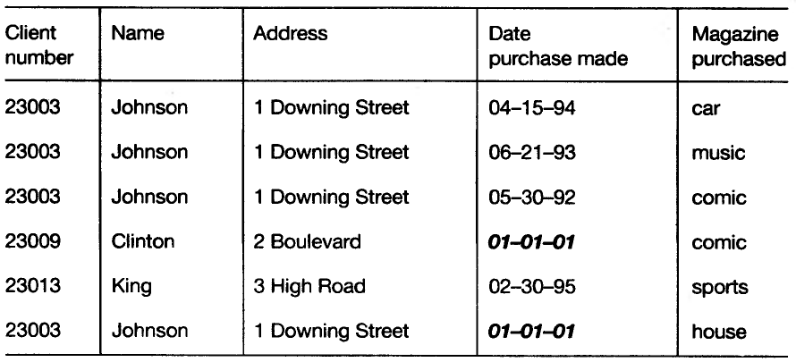
Figure: De-duplication

Slide 41
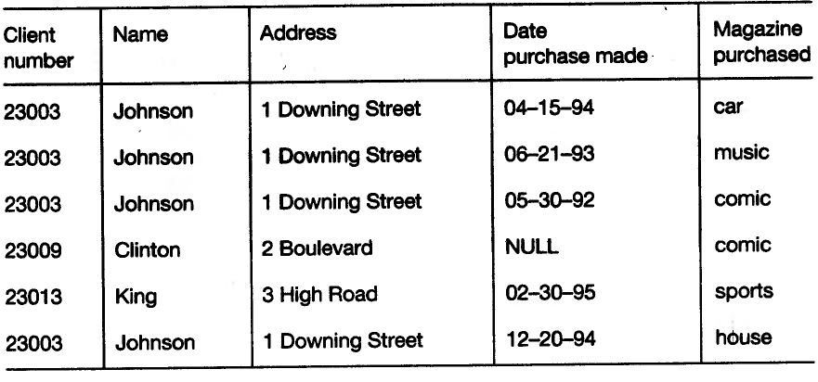
Figure: Domain Consistency

Slide 42
Enrichment
Matching the information from bought-in databases with your own databases can be difficult. A well-known problem is the reconstruction of family relationships in databases. In a relational environment, we can simply join this information with our original data.

Slide 43
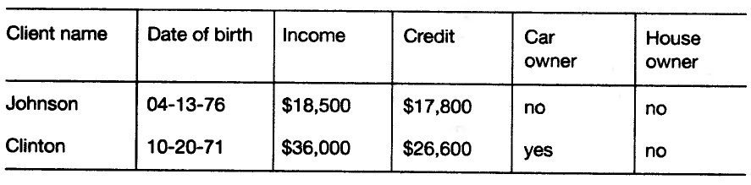
Figure: Enrichment

Slide 44
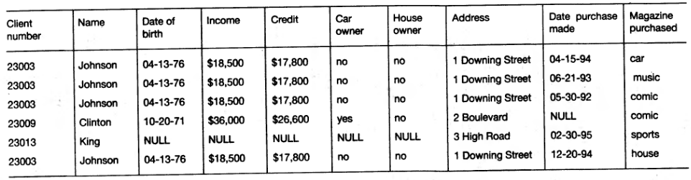
Figure: Enriched Table

Slide 45
Coding
We can apply following coding technique:
Address to regions
Birthdate to age
Divide income by 1000
Divide credit by 1000
Convert cars yes/no to 1/0
Convert purchased date to months numbers

Slide 46
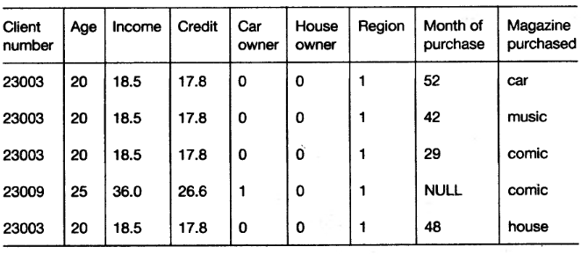
Figure: After Coding Stage

Slide 47
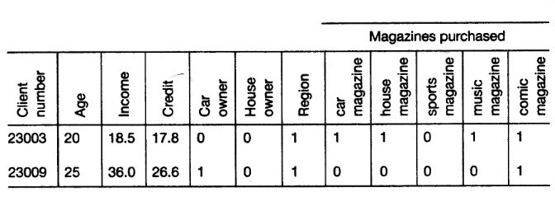
Figure: Final Table

Slide 48
Data Mining
It is a discovery stage in KDD process.
Data mining refers to extracting or “mining” knowledge from large amounts of data.
Many people treat data mining as a synonym for another popularly used term, Knowledge Discovery from Database, or KDD.
Alternatively, others view data mining as simply an essential step in the process of knowledge discovery.

Slide 49
Some Alternative names to data mining are:
Knowledge discovery (mining) in databases (KDD)
Knowledge extraction
Data/pattern analysis
Data archeology
Data Dredging
Information Harvesting
Business intelligence, etc.

Slide 50
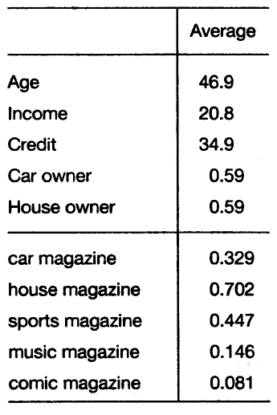
Figure: Averages

Slide 51
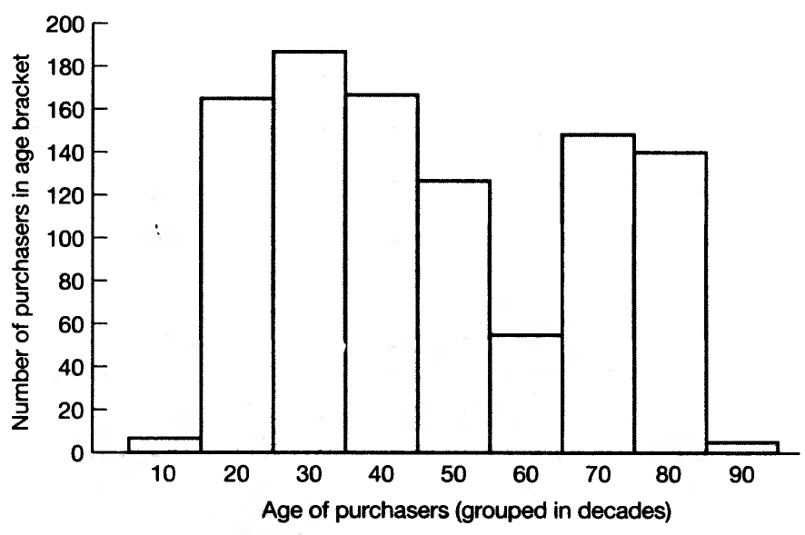
Figure: Age distribution of readers

Slide 52
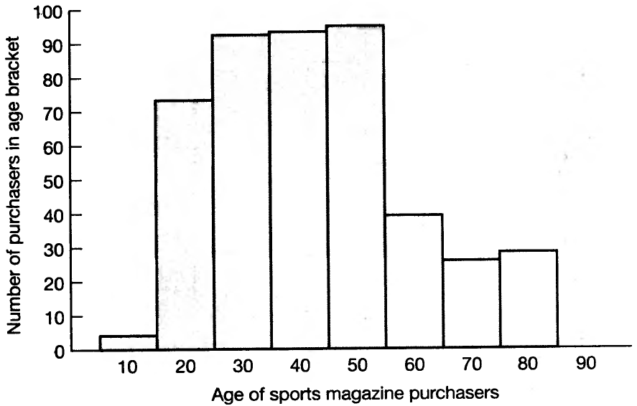
Figure: Age distribution of readers of sports magazines

Slide 53
Reporting
It uses two functions:
Analysis of the results
Application of results
Visualization and knowledge representation techniques are used to present the mined knowledge to the user.

Slide 54
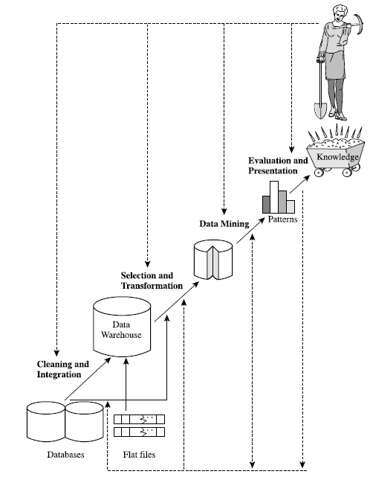
Figure: Data mining as a step in the process of knowledge discovery.

Slide 55
Data Mining: Confluence of Multiple Disciplines
Database
Systems
Statistics
Machine
Learning
Data Mining
Visualization
Algorithm
Other
Disciplines

Slide 56
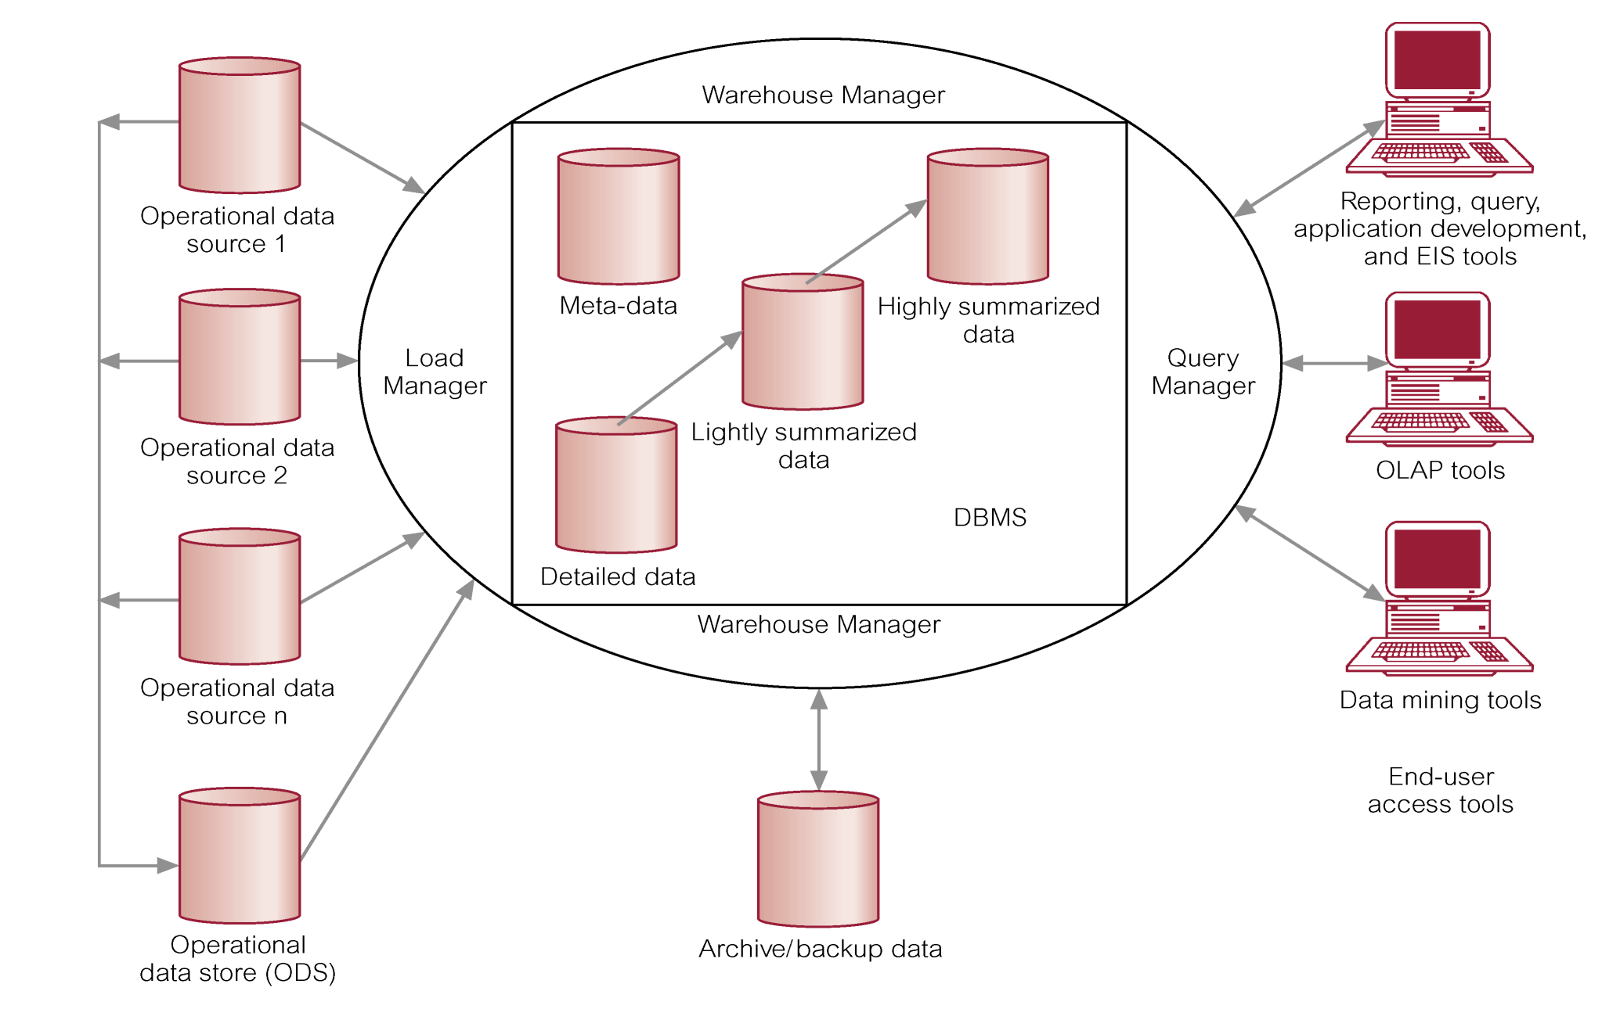
Data Warehouse Architecture

Slide 57
Operational Data Sources: It may include:
Network databases.
Departmental file systems and RDBMSs.
Private workstations and servers.
External systems (Internet, commercially available databases).
Operational Data Store (ODS): It is a repository of current and integrated operational data used for analysis.
Often structured and supplied with data in same way as DW.
May act simply as staging area for data to be moved into the warehouse.
Provides users with the ease of use of a relational database while remaining distant from decision support functions of the DW.

Slide 58
Warehouse Manager (Data Manager):
Operations performed include:
Analysis of data to ensure consistency.
Transformation/merging of source data from temp storage into DW
Creation of indexes.
Backing-up and archiving data.
Query Manager (Manages User Queries):
Operations include:
directing queries to the appropriate tables and
scheduling the execution of queries.
In some cases, the query manager also generates query profiles to allow the warehouse manager to determine which indexes and aggregations are appropriate.

Slide 59
Meta Data: This area of the DW stores all the meta-data (data about data) definitions used by all the processes in the warehouse.
Used for a variety of purposes:
Extraction and loading processes
Warehouse management process
Query management process
End-user access tools use meta-data to understand how to build a query.
Most vendor tools for copy management and end-user data access use their own versions of meta-data.

Slide 60
Lightly and Highly Summarized Data: It stores all the pre-defined lightly and highly aggregated data generated by the warehouse manager.
The purpose of summary info is to speed up the performance of queries.
Removes the requirement to continually perform summary operations (such as sort or group by) in answering user queries.
Archive/Backup Data: It stores detailed and summarized data for the purposes of archiving and backup.
May be necessary to backup online summary data if this data is kept beyond the retention period for detailed data.
The data is transferred to storage archives such as magnetic tape or optical disk.

Slide 61
End-User Access Tools:
The principal purpose of data warehousing is to provide information to business users for strategic decision-making.
Users interact with the warehouse using end-user access tools.
There are three main groups of access tools:
Data reporting, query tools
Online analytical processing (OLAP) tools (Discussed later)
Data mining tools (Discussed later)

Slide 62
Benefits of Data Warehousing
Queries do not impact Operational systems
Provides quick response to queries for reporting
Enables Subject Area Orientation
Integrates data from multiple, diverse sources
Enables multiple interpretations of same data by different users or groups
Provides thorough analysis of data over a period of time
Accuracy of Operational systems can be checked
Provides analysis capabilities to decision makers

Slide 63
Increase customer profitability
Cost effective decision making
Manage customer and business partner relationships
Manage risk, assets and liabilities
Integrate inventory, operations and manufacturing
Reduction in time to locate, access, and analyze information (Link multiple locations and geographies)
Identify developing trends and reduce time to market
Strategic advantage over competitors

Slide 64
Potential high returns on investment
Competitive advantage
Increased productivity of corporate decision-makers
Provide reliable, High performance access
Consistent view of Data: Same query, same data. All users should be warned if data load has not come in.
Quality of data is a driver for business re-engineering.

Slide 65
Applications of Data Mining
Data mining is an interdisciplinary field with wide and diverse applications
There exist nontrivial gaps between data mining principles and domain-specific applications
Some application domains
Financial data analysis
Retail industry
Telecommunication industry
Biological data analysis

Slide 66
Data Mining for Financial Data Analysis
Financial data collected in banks and financial institutions are often relatively complete, reliable, and of high quality
Design and construction of data warehouses for multidimensional data analysis and data mining
View the debt and revenue changes by month, by region, by sector, and by other factors
Access statistical information such as max, min, total, average, trend, etc.
Loan payment prediction/consumer credit policy analysis
feature selection and attribute relevance ranking
Loan payment performance
Consumer credit rating

Slide 67
Classification and clustering of customers for targeted marketing
multidimensional segmentation by nearest-neighbor, classification, decision trees, etc. to identify customer groups or associate a new customer to an appropriate customer group
Detection of money laundering and other financial crimes
integration of from multiple DBs (e.g., bank transactions, federal/state crime history DBs)
Tools: data visualization, linkage analysis, classification, clustering tools, outlier analysis, and sequential pattern analysis tools (find unusual access sequences)

Slide 68
Data Mining for Retail Industry
Retail industry: huge amounts of data on sales, customer shopping history, etc.
Applications of retail data mining
Identify customer buying behaviors
Discover customer shopping patterns and trends
Improve the quality of customer service
Achieve better customer retention and satisfaction
Enhance goods consumption ratios
Design more effective goods transportation and distribution policies

Slide 69
Example 1. Design and construction of data warehouses based on the benefits of data mining
Multidimensional analysis of sales, customers, products, time, and region
Example 2. Analysis of the effectiveness of sales campaigns
Example 3. Customer retention: Analysis of customer loyalty
Use customer loyalty card information to register sequences of purchases of particular customers
Use sequential pattern mining to investigate changes in customer consumption or loyalty
Suggest adjustments on the pricing and variety of goods
Example 4. Purchase recommendation and cross-reference of items

Slide 70
Data Mining for Telecommunication Industry
A rapidly expanding and highly competitive industry and a great demand for data mining
Understand the business involved
Identify telecommunication patterns
Catch fraudulent activities
Make better use of resources
Improve the quality of service
Multidimensional analysis of telecommunication data
Intrinsically multidimensional: calling-time, duration, location of caller, location of callee, type of call, etc.

Slide 71
Fraudulent pattern analysis and the identification of unusual patterns
Identify potentially fraudulent users and their typical usage patterns
Detect attempts to gain fraudulent entry to customer accounts
Discover unusual patterns which may need special attention
Multidimensional association and sequential pattern analysis
Find usage patterns for a set of communication services by customer group, by month, etc.
Promote the sales of specific services
Improve the availability of particular services in a region
Use of visualization tools in telecommunication data analysis

Slide 72
Biomedical Data Analysis
DNA sequences: 4 basic building blocks (nucleotides): adenine (A), cytosine (C), guanine (G), and thymine (T).
Gene: a sequence of hundreds of individual nucleotides arranged in a particular order
Humans have around 30,000 genes
Tremendous number of ways that the nucleotides can be ordered and sequenced to form distinct genes
Semantic integration of heterogeneous, distributed genome databases
Current: highly distributed, uncontrolled generation and use of a wide variety of DNA data
Data cleaning and data integration methods developed in data mining will help

Slide 73
Similarity search and comparison among DNA sequences
Compare the frequently occurring patterns of each class (e.g., diseased and healthy)
Identify gene sequence patterns that play roles in various diseases
Association analysis: identification of co-occurring gene sequences
Most diseases are not triggered by a single gene but by a combination of genes acting together
Association analysis may help determine the kinds of genes that are likely to co-occur together in target samples
Path analysis: linking genes to different disease development stages
Different genes may become active at different stages of the disease
Develop pharmaceutical interventions that target the different stages separately
Visualization tools and genetic data analysis

Slide 74
Problems in Data Warehousing
Underestimation of resources for data loading
Hidden problems with source systems
Required data not captured
Increased end-user demands
Data homogenization
High demand for resources
Data ownership
High maintenance
Long duration projects
Complexity of integration

Slide 75
Major Challenges in Data Warehousing
Data mining requires single, separate, clean, integrated, and self-consistent source of data.
A DW is well equipped for providing data for mining.
Data quality and consistency is essential to ensure the accuracy of the predictive models.
DWs are populated with clean, consistent data
Advantageous to mine data from multiple sources to discover as many interrelationships as possible.
DWs contain data from a number of sources.
Selecting relevant subsets of records and fields for data mining
requires query capabilities of the DW.
Results of a data mining study are useful if can further investigate the uncovered patterns.
DWs provide capability to go back to the data source.

Slide 76
The largest challenge a data miner may face is the sheer volume of data in the data warehouse.
It is quite important, then, that summary data also be available to get the analysis started.
A major problem is that this sheer volume may mask the important relationships the data miner is interested in.
The ability to overcome the volume and be able to interpret the data is quite important.

Slide 77
Major Challenges in Data Mining
Efficiency and scalability of data mining algorithms
Parallel, distributed, stream, and incremental mining methods
Handling high-dimensionality
Handling noise, uncertainty, and incompleteness of data
Incorporation of constraints, expert knowledge, and background knowledge in data mining
Pattern evaluation and knowledge integration
Mining diverse and heterogeneous kinds of data: e.g., bioinformatics, Web, software/system engineering, information networks
Application-oriented and domain-specific data mining
Invisible data mining (embedded in other functional modules)
Protection of security, integrity, and privacy in data mining

Slide 78
Warehouse Products
Computer Associates -- CA-Ingres
Hewlett-Packard -- Allbase/SQL
Informix -- Informix, Informix XPS
Microsoft -- SQL Server
Oracle -- Oracle7, Oracle Parallel Server
Red Brick -- Red Brick Warehouse
SAS Institute -- SAS
Software AG -- ADABAS
Sybase -- SQL Server, IQ, MPP

Slide 79
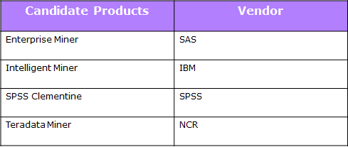
Data Mining Products

Slide 80
Questions?

Slide 81
References
1. “Knowledge Discovery Nuggets”: http://www.kdnuggets.com/
2. T. Bhavani. “Data Mining: Technologies, Techniques, Tools and Trends”, CRC Press 1999.
3. H. David, M. Heikki and S. Padhraic. “Principles of Data Mining”, MIT Press 2001.
4. U. M. Fayyad, G. Piatetsky-Shapiro, P. Smyth, and R. Uthurusamy. “Advances in Knowledge Discovery and Data Mining”, AAAI/MIT Press, 1996.
5. Sam Anahory, Dennis Murray, “Data warehousing In the Real World”, Pearson Education.

Slide 82
6. Adriaans, P. and D. Zatinge, “ Data Mining” , Addison Wesley, 1996
7. Kimball, R. “The Data Warehouse Toolkit”, Wiley, 1996.
8. “Data Mining Concepts and Techniques”, Morgan Kaufmann J. Han, M Kamber Second Edition ISBN : 978-1-55860-901-3
9. U. Fayyad, G. Grinstein, and A. Wierse. “Information Visualization in Data Mining and Knowledge Discovery. Morgan Kaufmann”, 2001.
10. H. Witten and E. Frank. “Data Mining: Practical Machine Learning Tools and Techniques with Java Implementations”, Morgan Kaufmann, 2001.

Slide 83
End of Unit 1

Slide 84
Thank you !!!

